Slide 1
Emotions

Slide 2
Emotions
Emotions: a subjective feeling that is directed toward some object.
Adaptive.
Directed towards other objects, people, or events.
Self-conscious emotions: directed towards one’s self or one’s own behaviors.
Affect: any experience of feeling or emotion, often described in terms of positive or negative affect.
Mood: any short-lived emotional state.

Slide 3
Emotions
Components of emotions:
Cognitive: awareness of experience.
Physiological: bodily arousal.
Behavioral: expressive behaviors.
Which order?
Cognition (conscious awareness), then feeling.
Physical response, then feeling and conscious awareness.

Slide 4
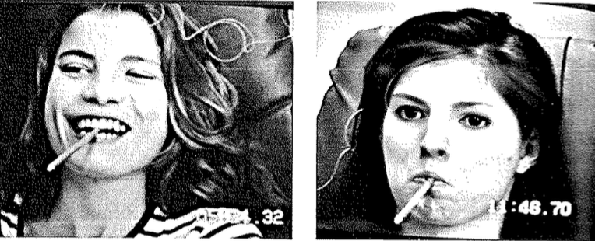
James-Lange Theory
The physical response comes first, then the emotion.
In order to experience emotion, you must first perceive your body’s arousal.
Physiological events (e.g. muscle tension, heart rate) create emotional reactions.
Facial feedback effect: our facial expressions feed our emotions.

Slide 5
James-Lange Theory
Lower your eyebrows toward your cheeks. Sigh. Close your mouth and push your lower lip slightly upward. Sigh again.
Sit back in your chair and draw your feet under the chair. Be sure you feel no tension in your legs or feet. Sigh again.
Fold your hands in your lap, cupping one in the other. Drop your head, letting your rib cage fall, letting most of your body go limp, except for a little tension in the back of your neck and across your shoulder blades. Sigh again.

Slide 6
Canon-Bard Theory
Emotions and physiological arousal occur simultaneously.
Experienced emotion and physiological response are separate, one does not cause the other.
Physiological responses not distinct enough to evoke different emotions.

Slide 7
Two-Factor Theory (Schachter-Singer)
Emotions have two components: physiological arousal and a cognitive label.
Encounter an emotion provoking event.
Experience a state of undifferentiated arousal.
Seek to explain the source of this autonomic arousal.
4. Label the emotion.
The emotional experience is produced by physical arousal paired with interpretation of the situation (cognition).
Labeling process can often be automatic and unconscious.

Slide 8
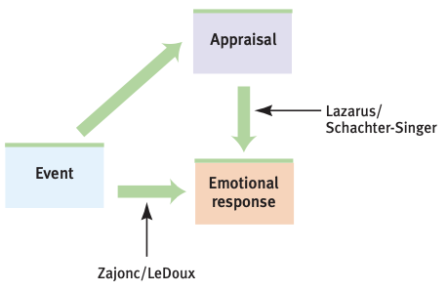
Two-Factor Theory (Schachter-Singer)
Appraisal Process
Conscious and unconscious processes can evoke emotion.
Some emotions do not require conscious processing (e.g. likes, dislikes, fears).
Other emotions are influenced by our memories, expectations, and interpretations.

Slide 9
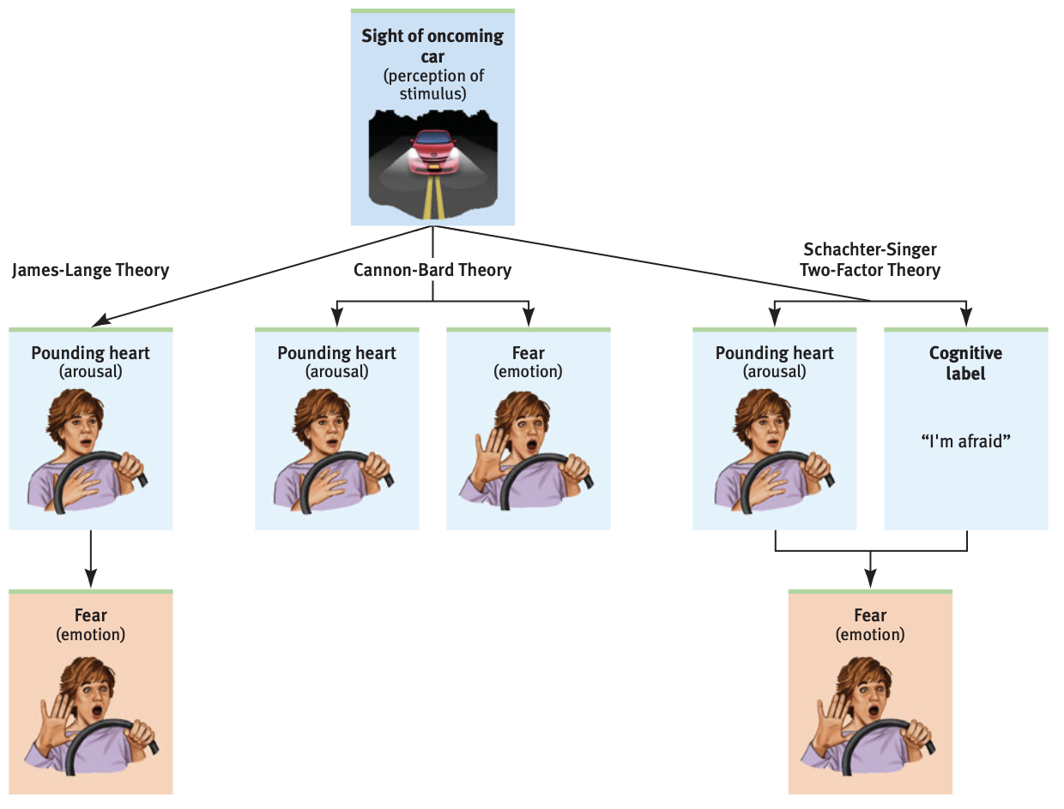

Slide 10
Physiological Reactions
Emotions associated with changes in heart rate, blood pressure, breathing, etc.
Triggered automatically, sometimes too small to detect.
Observing angry faces activates amygdala.
Negative emotions linked to right hemisphere, positive emotions to the left hemisphere.
Polygraph: used to measure subtle variations in breathing, muscle tension, heart rate, etc.
Better than chance, but high error rate. Unreliable.
Validity

Slide 11
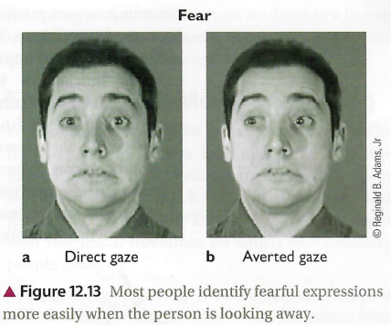
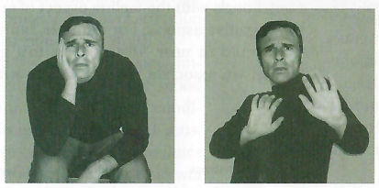
Non-Verbal Communication
Facial expressions, voice intonation, physical distance, eye contact, silence.
Not rule-bound, open to interpretation.
Mostly automatic, unconscious.
Unconscious actions perceived as more genuine than deliberate ones.
Non-verbals such as posture and eye contact give important clues about emotions.

Slide 12
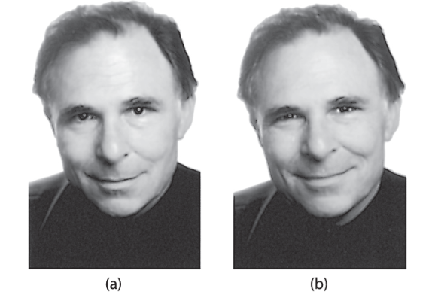
Facial Expressions
Facial expressions to convey emotions are innate and generally universal.
Duchenne smile: product of genuine positive emotion, includes activation of muscles around eyes.
Even babies can recognize real vs. fake smiles.
Infants display emotions via facial expressions.

Slide 13
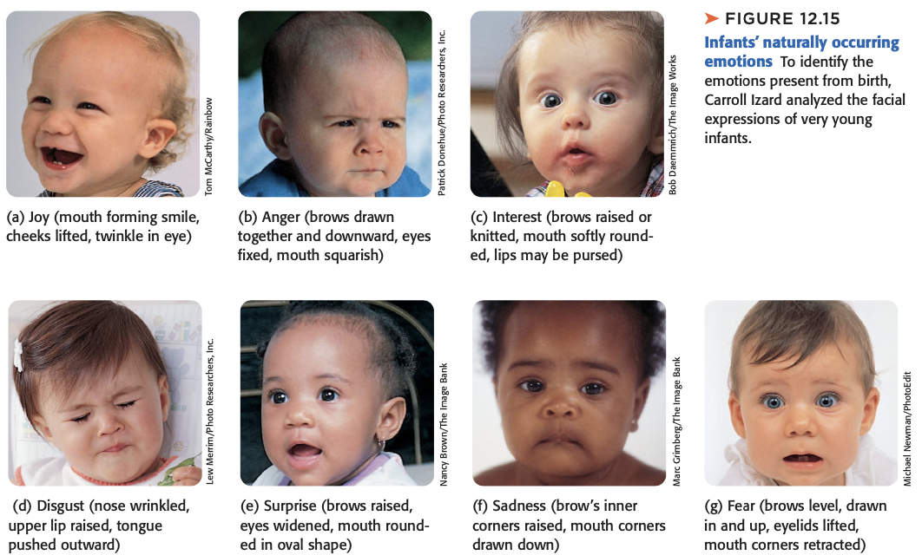

Slide 14
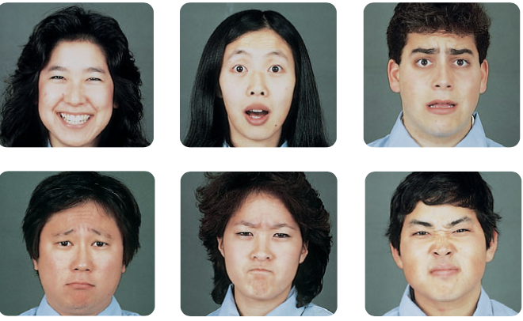
Facial Expressions
Six emotions that are recognized across cultures.
Isolated tribes recognize happiness but difficulty with the rest (suggests cultural influence).

Slide 15
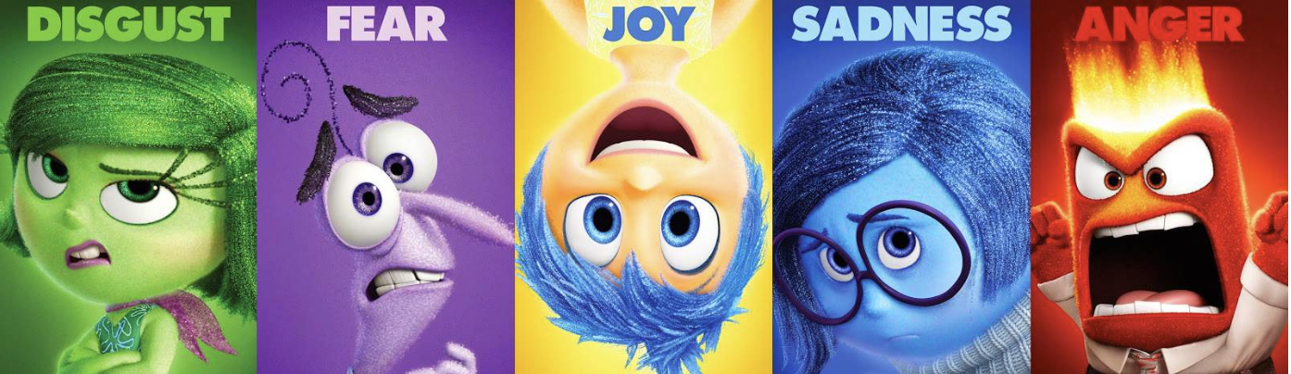
Facial Expressions
Happiness
Surprise
Fear
Sadness
Anger
Disgust

Slide 16
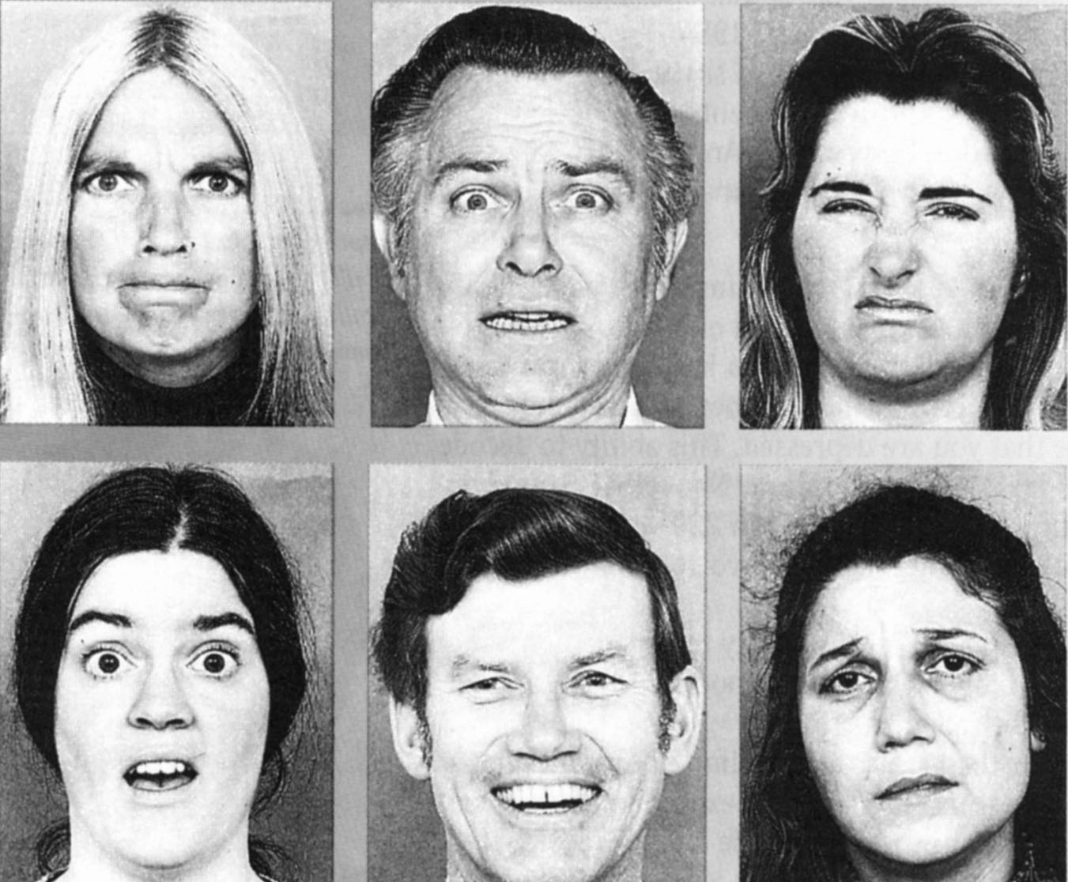
Facial Expressions
Each emotion linked with a characteristic set of muscular changes.
Happiness from the mouth, easiest to identify.
Anger and fear mostly in eyes.
Disgust in nose and eyes.
Evolutionarily advantageous.
Thought to be universal, but display rules differ.

Slide 17
Facial Expressions
Judging emotions with eyes alone:
http://socialintelligence.labinthewild.org/mite/
Introverts better at reading others’ emotions.
Extroverts easier to read.
Communication without non-verbal cues can be difficult.
Non-verbals used for communication in a social context.

Slide 18
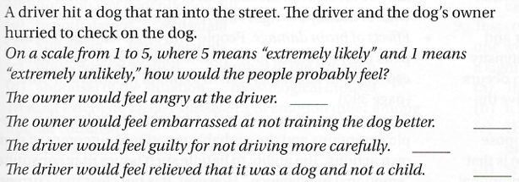
Emotional Intelligence
Difficult to measure because there might not be a correct answer.
There might be a clearly wrong answer, but several correct ones.
Who would be an “expert” to determine scoring?
Low reliability.
Scores tend to correlate with overall intelligence, conscientiousness, and other personality traits.
Needs better measurement.

Slide 19
Emotional Regulation & Labor
Emotional regulation: the ability to manage the type, intensity, length, and expression of one’s emotions.
Display rules: norms requiring individuals to display certain emotions and withhold others.
Different cultures and workplaces have different display rules.
Emotional labor: the effort, planning, and control needed to express culturally or organizationally desired emotions during interpersonal transactions.

Slide 20
Emotional Labor
Surface acting: modifying behavior to be consistent with required emotions but continue to hold different internal feelings.
Deep acting: changing true emotions to match the required emotions.
Emotional dissonance: conflict between a person’s required and true emotions.
The larger the gap between required and true emotions, the more stress, burnout, and psychological separation from self.
Difficult to suppress automatic behaviors and display contradicting ones.
Deep acting as a way to lessen emotional labor.

Slide 21
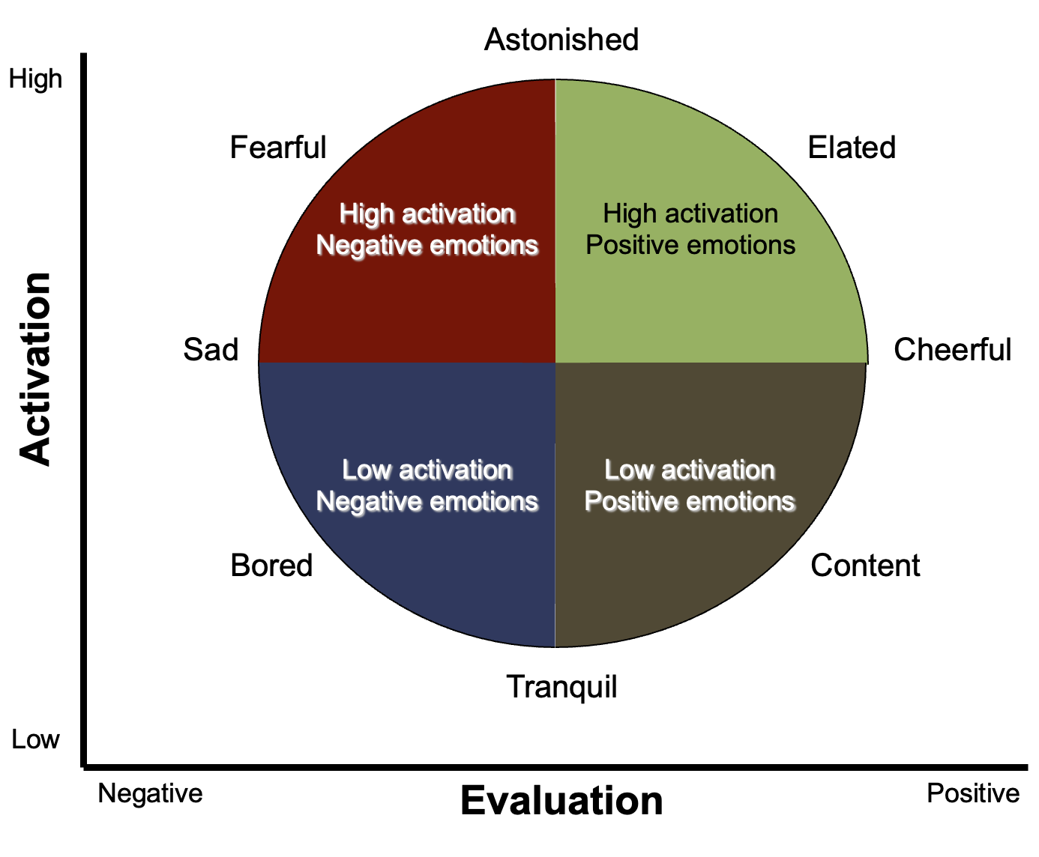
Dimensions of Emotion
Evaluation
Positive/ Negative
Activation
Extent to which the emotion produces alertness and motivation to act.
Intensity

Slide 22
Anger
Catharsis: emotional release, the hypothesis that “releasing” aggressive energy relieves aggressive urges.
Rumination: repetitive thinking or dwelling on negative feelings.
Anger management strategies:
Wait: bring down level of physiological arousal.
Redirect energy on different activities.
Controlled expression
Constructive anger: constructive discussion of one’s feelings, action that can improve the situation.
Destructive anger: doesn’t solve the deeper issue (e.g. revenge, fighting).

Slide 23
Happiness
Feel good, do good phenomenon
Tendency to be helpful when already in a good mood.
Does money buy happiness?
Need resources to meet basic needs.
Positivity effect
Tendency for people to remember more positive than negative information.
Increases with age.

Slide 24
Happiness
Affective forecasting: ability to predict our own and others’ happiness.
Durability bias: belief that our good and bad moods will last longer than they do.
Hedonic adaptation: tendency for our moods to adapt to our external circumstances.
Generally have a natural, stable baseline.
Events can cause a surge of either positive or negative affect.
We adapt to this new level and come to consider it normal.
https://www.youtube.com/watch?v=4q1dgn_C0AU

Slide 25
What Makes Us Happy?
Belonging
Social relationships
Group membership
Shared experiences
Community
Focusing on the positive
Positivity effect
Writing about gratitude
Acts of kindness
Acting happy
James-Lange Theory
Growth/ self-actualization
Work and leisure that is fulfilling
Focus on self
Physical well-being
Sleep
Exercise
Spending time in nature

